Slide 1


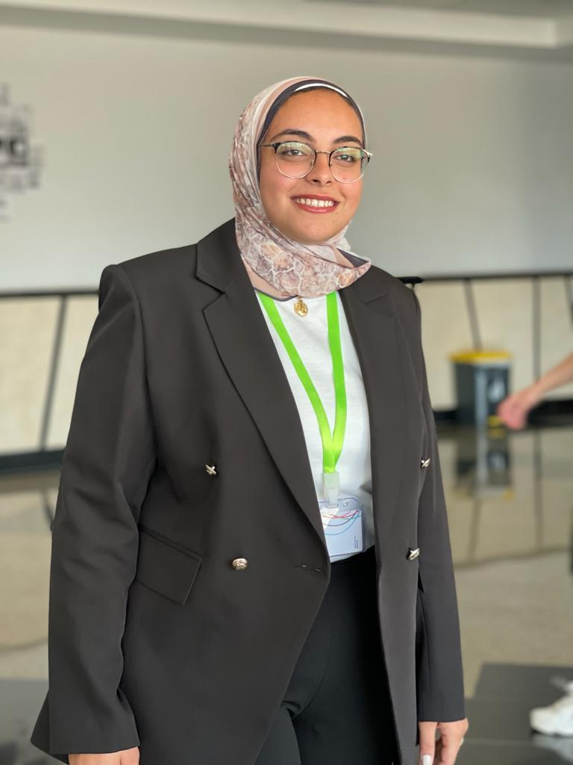
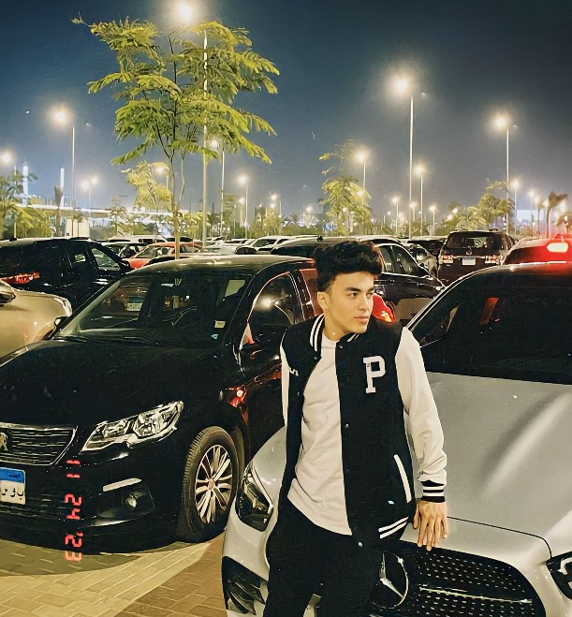
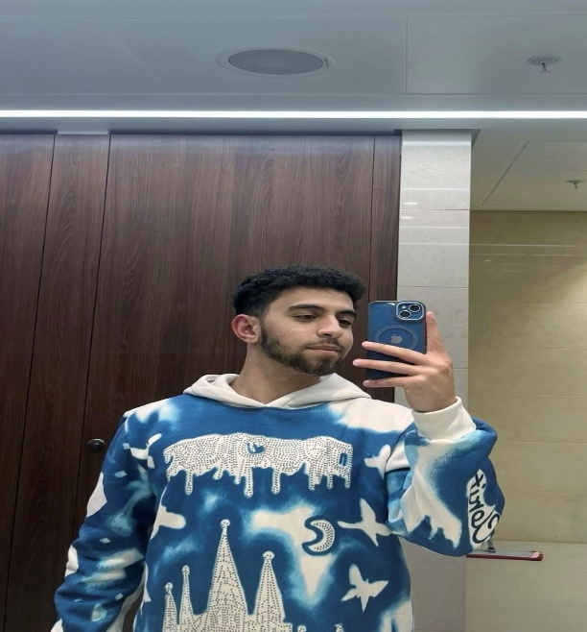
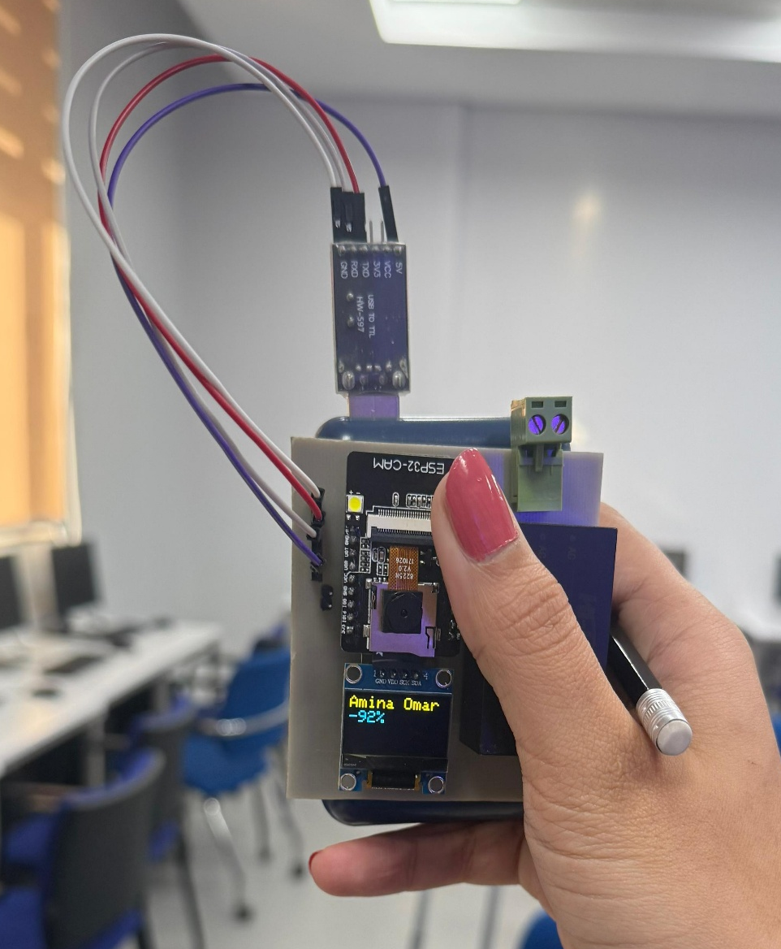
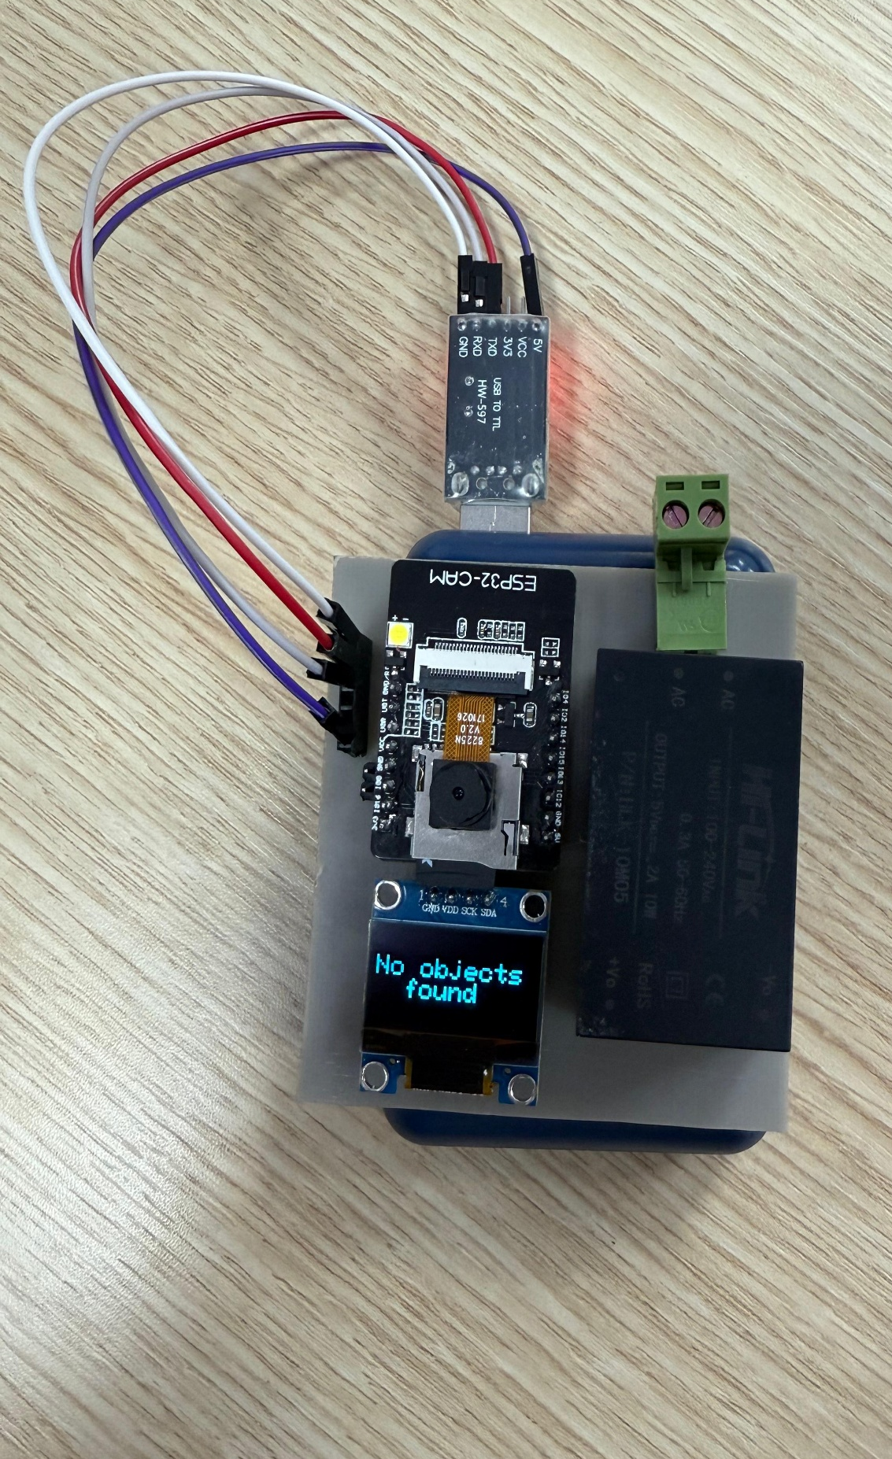

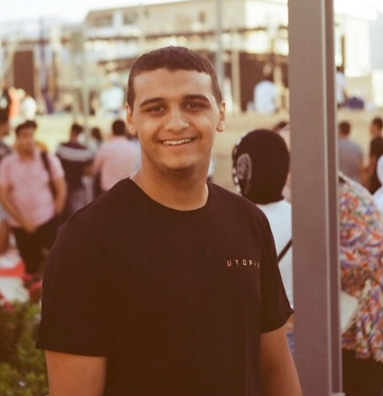
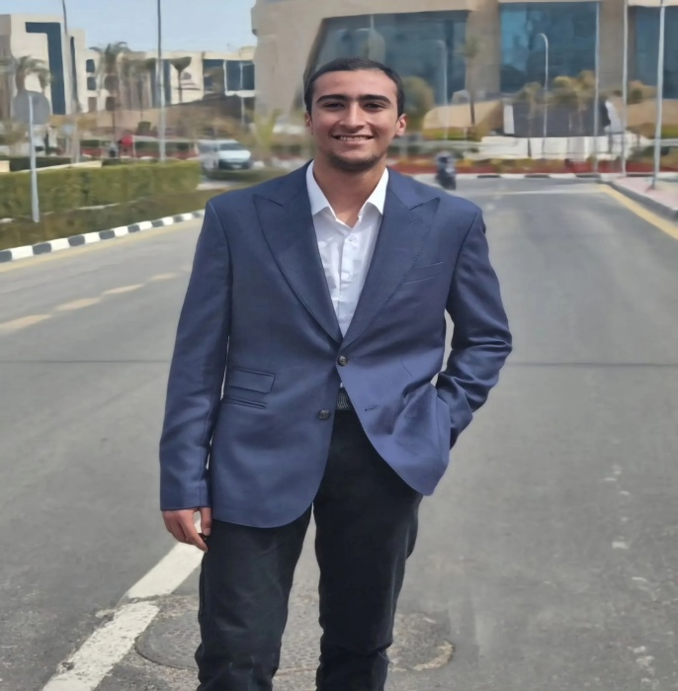
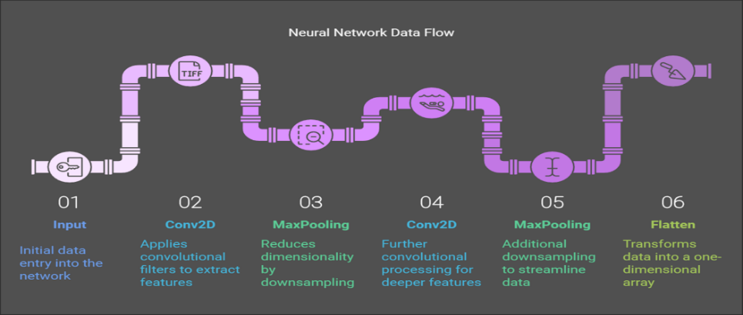

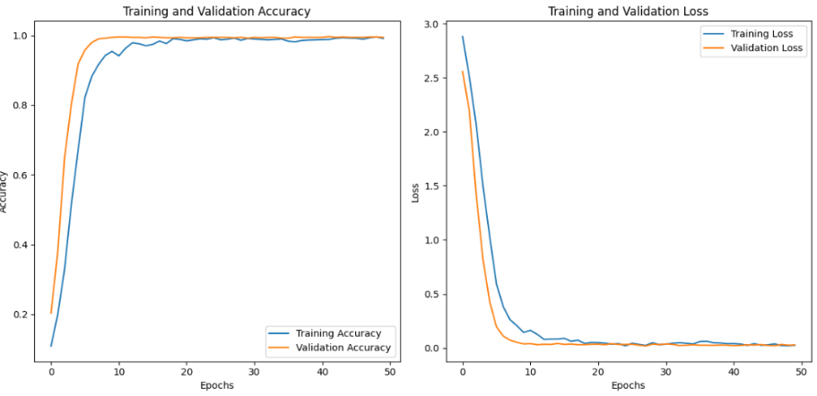
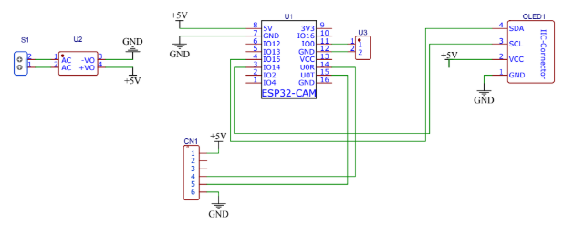
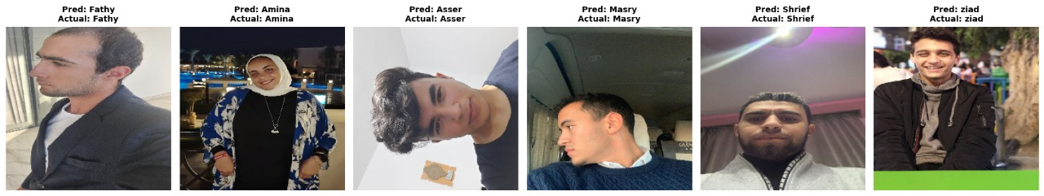

Real-Time Face Recognition and ESP32-CAM Using Neural Networks
Course: Neural network (AIE231)
Aser Mohamed: 222102487, Sherif farag: 222100822, Amina elshabandy: 222100306, Ahmed Mohamed: 222100822, Ziad Abdelrahman: 221101043, Mohamed Ahmed: 221101699
Under supervision of: Dr. Amjad Bayoumy
Dataset
Experimental results
Project
Neural architecture
Accuracy and validation
Simulation
Testing

